Slide 1



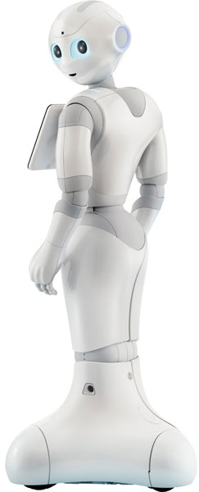
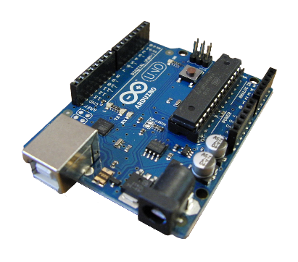
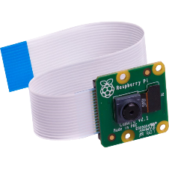
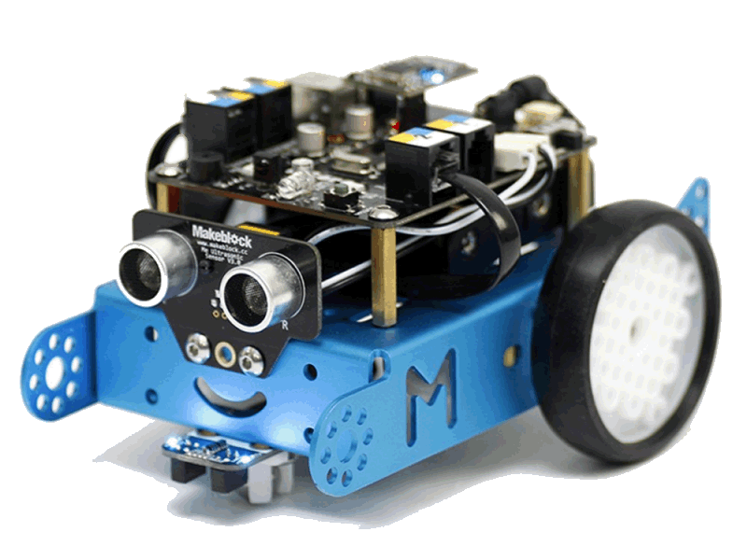
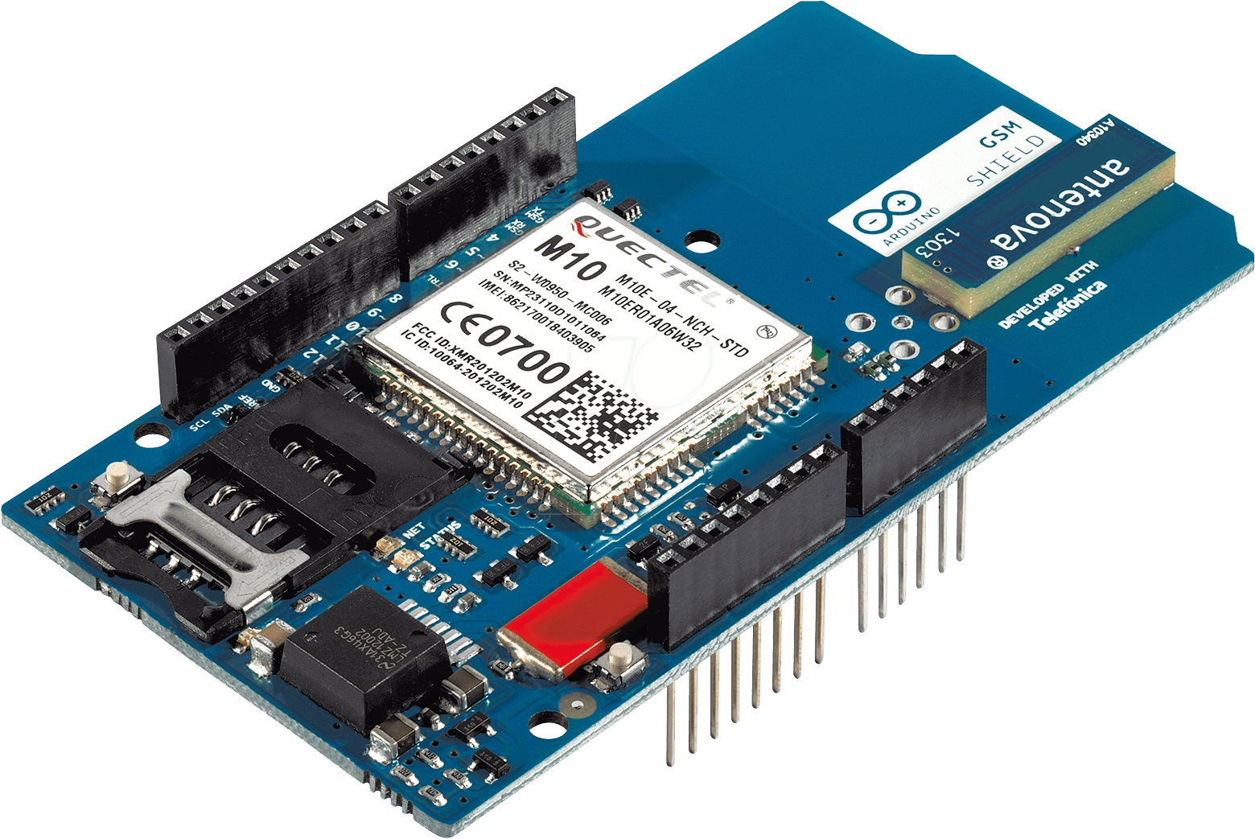

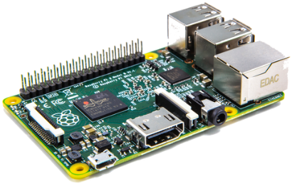



SCSE19074 – An Affective Computing Companion
Presented by Timothy Low
Supervised by Dr Smitha Kavallur Pisharath Gopi
Introduction
The world’s elderly population is projected to grow to 17% of the world’s population by 2050. This increases the necessity for elderly care, including health monitoring and home assistance. In addition, loneliness and mental health issues are also prevalent in the aged population, with suicides for individuals aged 60 and above hitting a record high in 2017.
The system proposed is an affective companion robot for the elderly. It provides a variety of assistive, communicative, and health tracking features. As there exists strong evidence that the presence of a companion is beneficial to mental health, the system assumes the role of a pet, to alleviate loneliness.
Current Market
Design & Implementation
Pepper is an healthcare robot that can identify visitors and make appointments. However, it is not designed for domestic use, having no personalized functions, and costing 200,000 JPY. Therefore, the objective of this project is to create a robot for domestic use that can be manufactured with low-cost hardware components.
A home system was initially considered. However, this would not fulfil the goal of providing a companion to alleviate loneliness. Therefore, a robot with a physical presence was chosen.
Arduino: Hardware Control
RPi Camera:
Vision & Recognition
GSM Module:
Smartphone Communications
Proposition
Home Assistant: Sends & receives texts, voice messages, and news headlines. Checks door & identifies visitor before the individual has to get up.
Infrared & Sonar:
Tracking & Object Detection
Raspberry Pi:
Computer Control
Health Monitor: Checks in on the individual at intervals, taking photos and sending them to their loved ones. Monitors their heart rate.
Motors:
Allow Rotation in Place
Movement & Tracking
Obstacle Navigation
Camera & Face Detection
Smartphone Comms.
Audio-Visual Comms.
Affective Companion: Moves around, and provides a companion to talk to. Reminds them to take their medication.
Conclusion
These features will assist with home tasks to reduce dangers that can arise from small accidents in the home.
Preliminary work shows that rapid facial recognition and personalization is feasible with more economically-priced hardware.
Future Improvements
Track sleep quality and other relevant health metrics.
Modify chassis to increase pet-like visual appeal.
This enables an affordable solution to the mass-market demand for affective computing.
References
https://www.straitstimes.com/singapore/number-of-suicides-among-seniors-hits-record-high
https://bmcpsychiatry.biomedcentral.com/articles/10.1186/s12888-018-1613-2
URECA
Undergraduate Research Programme
www.ntu.edu.sg

